Slide 1

RETAIL SALES ANALYTICS
PRESENTED BY
SATHYANARRAYANAN

Slide 2

PROJECT OVERVIEW
1. Objective
Analyze sales performance across stores and staff to identify strengths and weaknesses.
Understand customer buying behavior and segment customers for targeted marketing.
Monitor inventory levels and product performance to support stock optimization.
2. Business Context
In a competitive retail market, tracking performance and understanding customers are essential for growth.
Retailers need insights to identify high-value customers, manage inventory, and maximize ROI.
Data-driven strategies can improve decision-making and enhance operational efficiency.
3. Dataset Overview
Dataset: Retail Sales Data in a relational schema with tables for customers, orders, products, brands, categories, stocks, stores, and staffs.
Includes detailed transactional data, product details, brand/category info, and stock levels per store.
Enables analysis from multiple angles - sales, inventory, customer behaviour and store performance.

Slide 3

PROJECT OVERVIEW
4. Problem Statement
Businesses lack an integrated solution to monitor sales, track customers, and manage inventory in real-time.
Need for an end-to-end analytics pipeline that delivers actionable insights for business growth.
5. Proposed Solution
Build an analytics pipeline integrating Excel (data cleaning), SQL (data storage/querying) and Power BI (dashboards).
Create interactive dashboards with sales trends, store performance, product analysis, and low-stock alerts.
6. Key Deliverables
Fully cleaned and processed dataset stored in SQL for analysis.
Interactive Power BI dashboard with KPIs like brand analysis, customer analysis, sales trends, product & stock analysis, store & staff analysis.
7. Expected Impact
Improved revenue through better targeting of high-value customers.
Enhanced inventory management, reducing stockouts and overstock situations.
Data-driven decision-making leading to higher efficiency and competitive advantage.

Slide 4
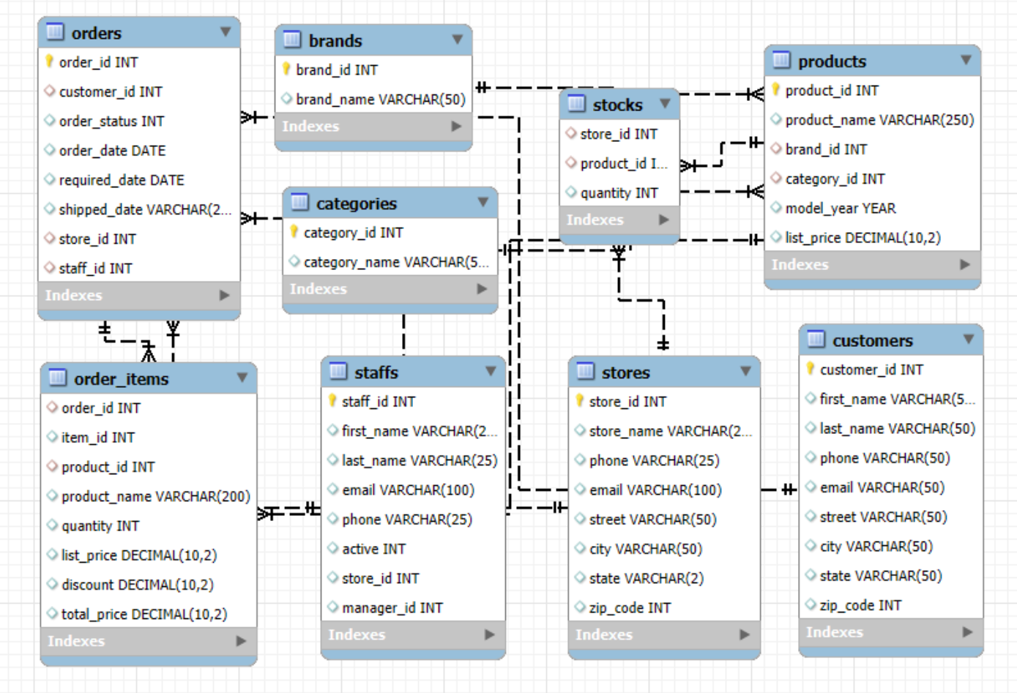
SQL - ER DIAGRAM
Primary Keys (PK)
Orders - order_id
Brands - brand_id
Categories - category_id
Products - product_id
Order_items - order_id, item_id
Staffs - staff_id
Stores - store_id
Customers - customer_id

Slide 5
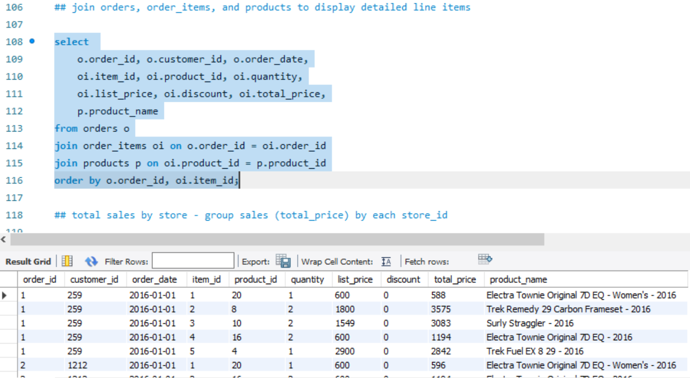
SQL - ANALYSIS
Process: Joined orders, order_items, and products tables to generate a detailed report with order information, total price and product names.
Output: Exported to Excel as a structured dataset showing quantities, prices, discounts, and product details, sorted by order and item IDs.

Slide 6
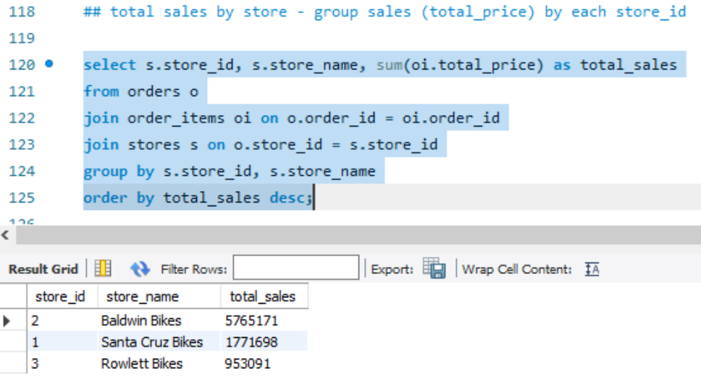
SQL - ANALYSIS
Process: Calculated total sales per store by summing total_price from order_items, joined with orders for store references and stores for names, grouped by store.
Output: Exported to Excel showing store IDs, names, and total sales in descending order.

Slide 7
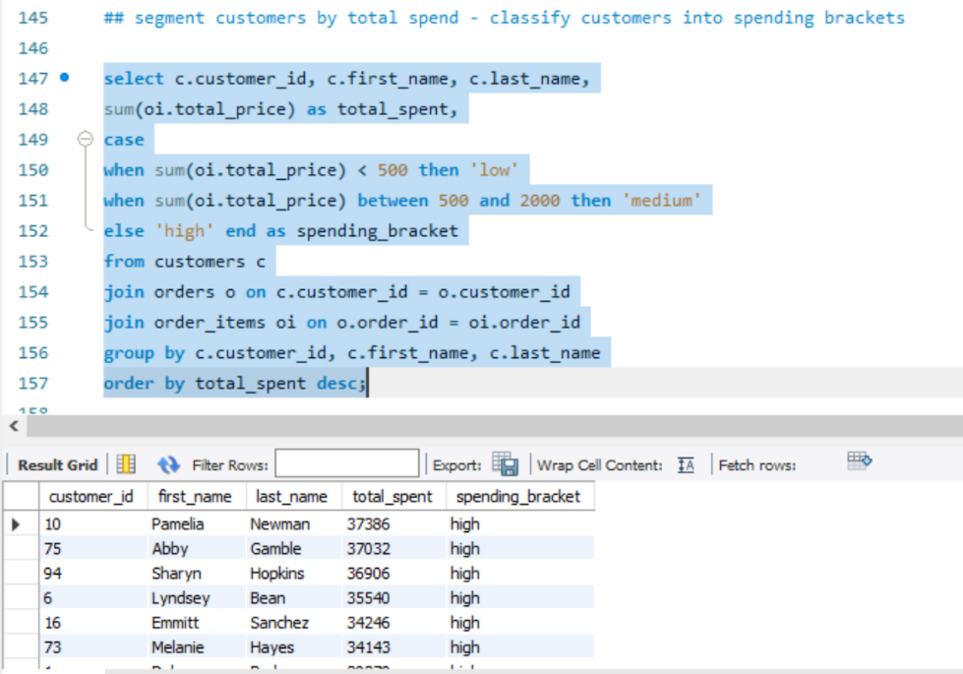
SQL - ANALYSIS
Process: Segmented customers into spending brackets (low, medium, high) by aggregating their total purchases from order_items, joined with orders and customers.
Output: Exported to Excel showing customer names, total spending, and assigned brackets, sorted by highest spenders first.

Slide 8
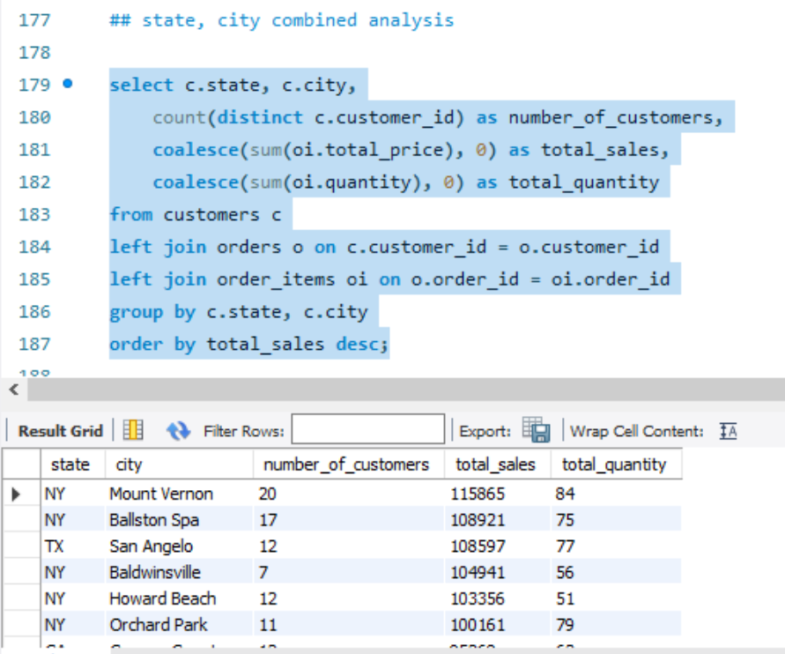
SQL - ANALYSIS
Process: Analyzed customer distribution and sales performance by geographic location by joining customers, orders, and order_items tables.
Output: Exported to Excel showing top-performing locations, with New York (Mount Vernon) leading at $115,865 sales from 20 customers.

Slide 9
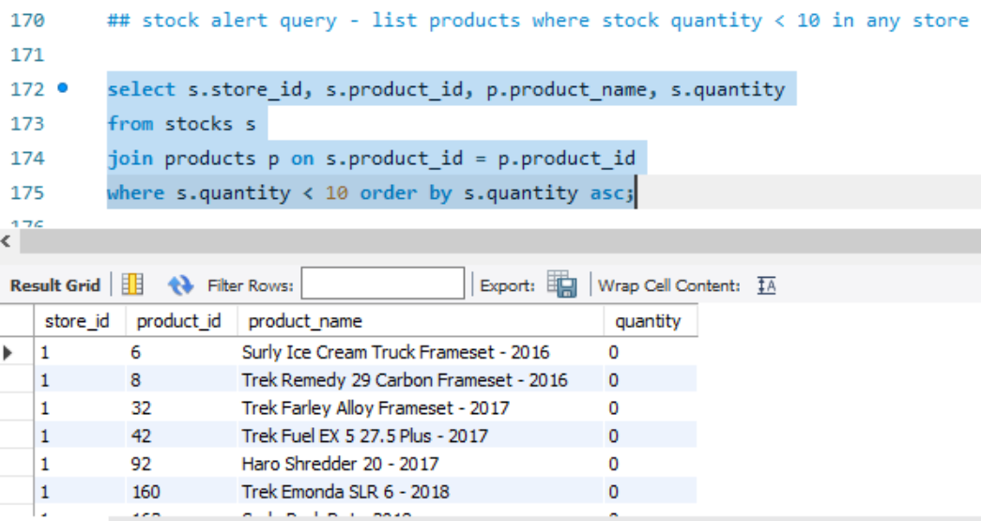
SQL - ANALYSIS
Process: Identified low-stock products (quantity < 10) by joining stocks and products tables, sorted by remaining quantity.
Output: Exported to Excel listing store IDs, product details, and stock levels for replenishment alerts.

Slide 10
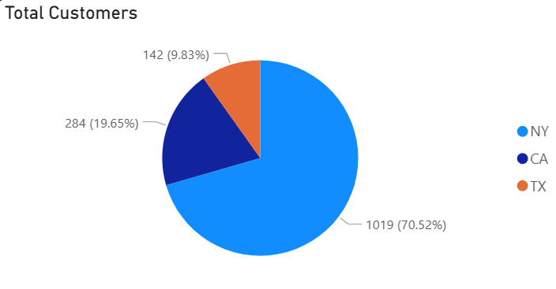
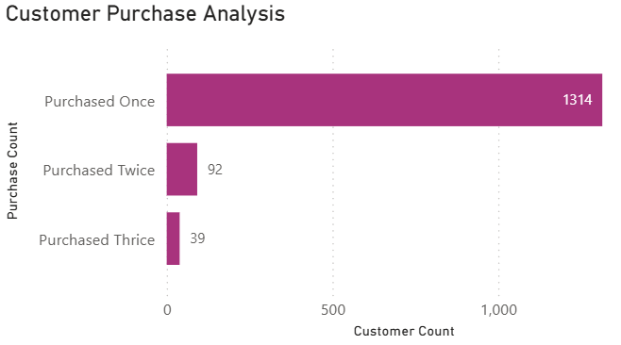
CUSTOMER ANALYSIS
The chart displays customer distribution by state, with New York (70.52%) as the largest market, followed by California (19.65%) and Texas (9.83%).
It also shows purchase frequency, revealing 1,314 one-time buyers, 92 repeat buyers (twice), and 39 frequent buyers (thrice).
The chart highlights New York dominance and low repeat purchase rates.

Slide 11
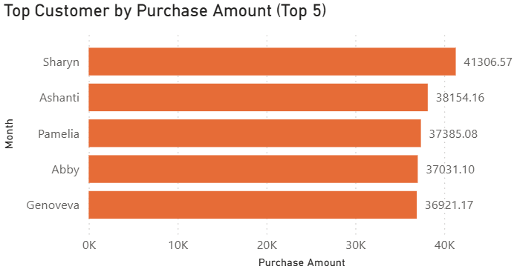
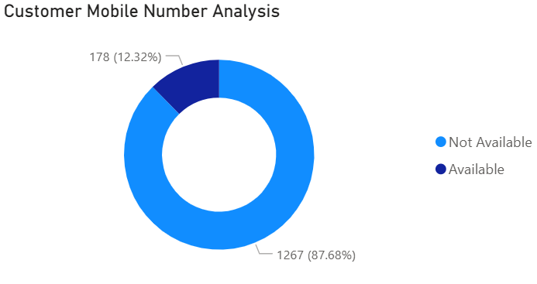
CUSTOMER ANALYSIS
Top 5 Customers by Purchase Amount, led by Sharyn ($41,306.57), followed by Ashanti, Pamelia, Abby, and Genoveva.
Mobile Number Availability, showing only 12.32% (178 customers) have numbers available, while 87.68% (1,267) are missing this data.
The chart highlights High-value customers are identified, but contact information is largely unavailable for most.

Slide 12
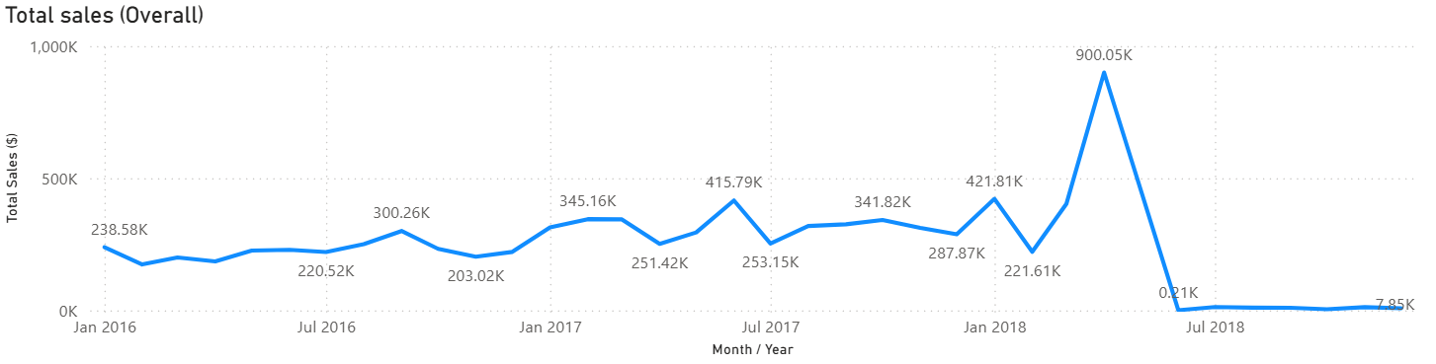
SALES ANALYSIS
The chart tracks overall sales performance from Jan 2016 to late 2018, showing steady fluctuations in the $200K–$420K range for most of the period.
Notable growth occurs in early 2017 and early 2018, culminating in a dramatic peak of $900.05K. This spike is followed by a sharp collapse to almost zero sales by mid-2018, with minimal recovery afterward.
The trend suggests a possible one-time event or campaign drove the peak, after which sales activity significantly declined.

Slide 13
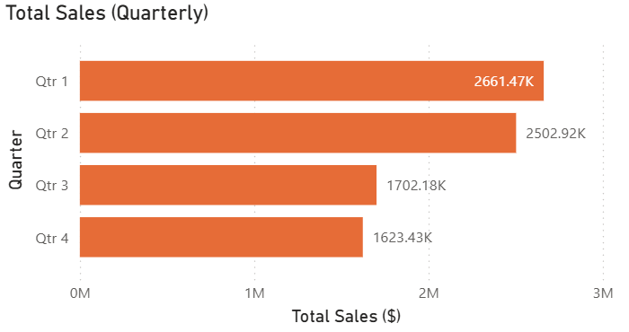
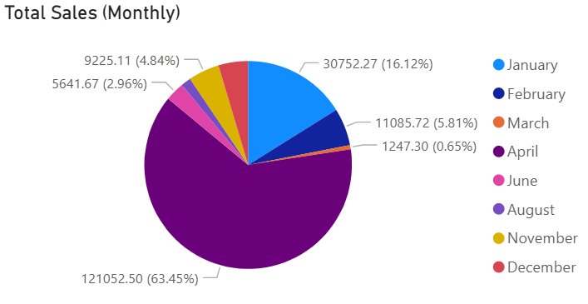
SALES ANALYSIS
The quarterly sales chart shows Q1 leading with $2.66M, closely followed by Q2 at $2.50M, while Q3 ($1.70M) and Q4 ($1.62M) lag behind.
Monthly sales distribution is heavily skewed, with one month (unlabelled in the pie but dominating) contributing 63.45% of total sales, suggesting a seasonal or event-driven spike.
January accounts for 16.12%, indicating a strong start to the year. Other months contribute marginally, with several under 6%, highlighting significant sales concentration in specific periods.

Slide 14
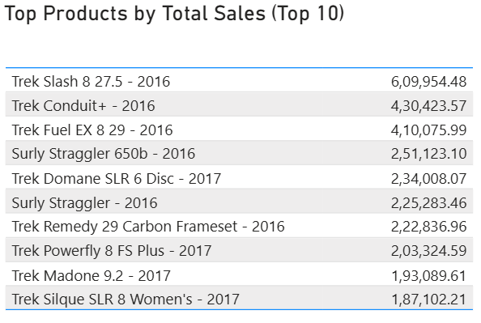
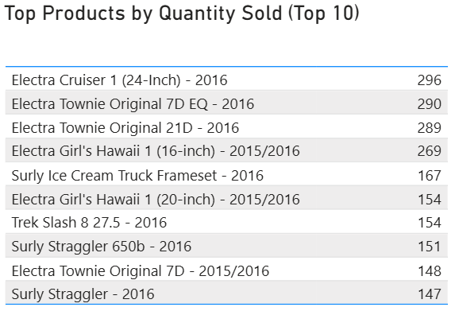
PRODUCT & STOCK ANALYSIS
The top product by sales value is Trek Slash 8 27.5 - 2016 with 609.95K, followed by Trek Conduit+ - 2016 (430.42K) and Trek Fuel EX 8 29 - 2016 (410.08K).
In terms of quantity sold, Electra Cruiser 1 (24-Inch) - 2016 leads with 296 units, closely followed by Electra Townie Original 7D EQ - 2016 (290 units) and Electra Townie Original 21D - 2016 (289 units).
This shows that high sales value products are not necessarily the highest in quantity sold, suggesting premium pricing on certain models. Trek dominates high-value sales, while Electra products lead in volume.

Slide 15
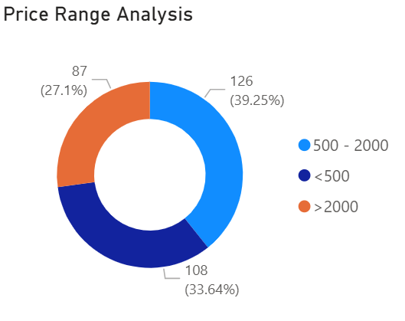
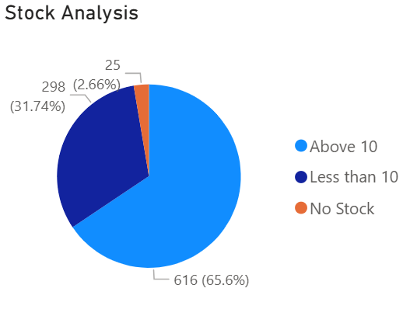
PRODUCT & STOCK ANALYSIS
The price range analysis shows that most products fall between 500–2000 (126 items, 39.25%), followed by those priced under 500 (108 items, 33.64%), and premium products above 2000 (87 items, 27.1%).
Stock analysis reveals that 65.6% of products (616 items) have more than 10 units in stock, while 31.74% (298 items) have less than 10 units.
Only 2.66% (25 items) are completely out of stock, indicating generally healthy inventory levels.

Slide 16
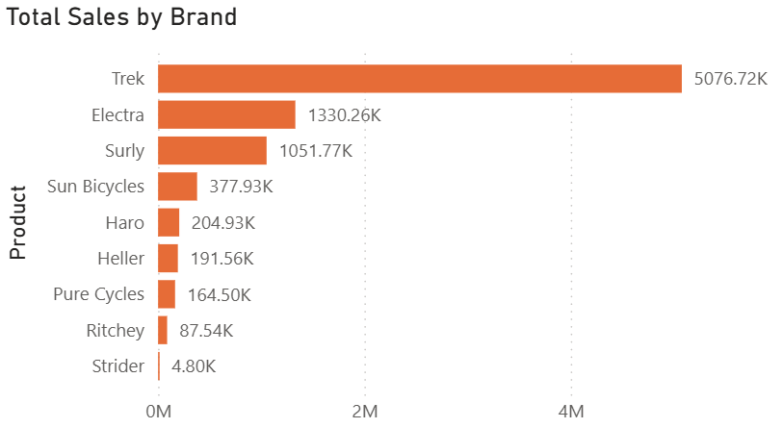
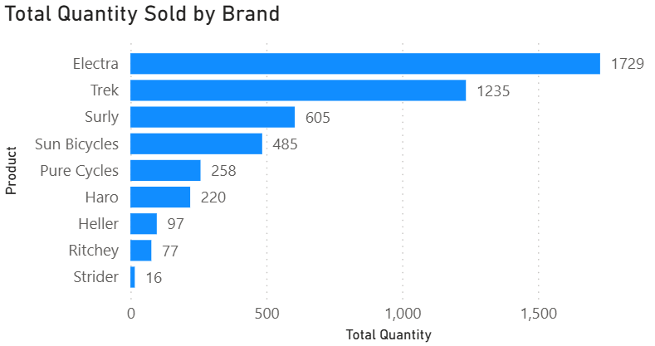
BRAND ANALYSIS
Trek leads total sales by a wide margin at 5076.72K, followed by Electra (1330.26K) and Surly (1051.77K). In terms of quantity sold, Electra ranks first with 1729 units, ahead of Trek (1235 units) and Surly (605 units).
This indicates Trek’s dominance in revenue is driven by higher-priced products, while Electra’s strength lies in sales volume.
Brands like Sun Bicycles and Pure Cycles perform moderately in both sales and quantity, while Strider records minimal figures in both categories.

Slide 17
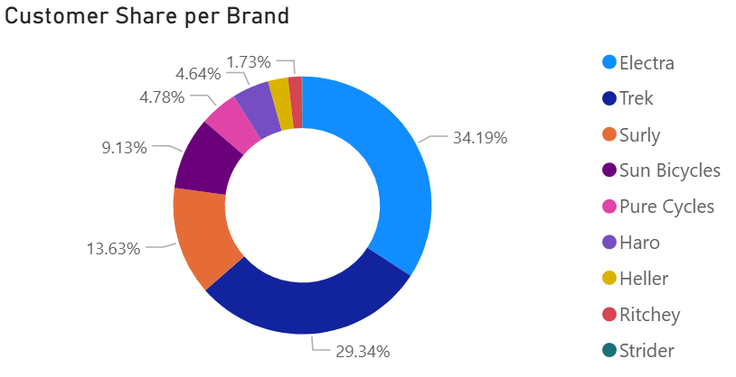
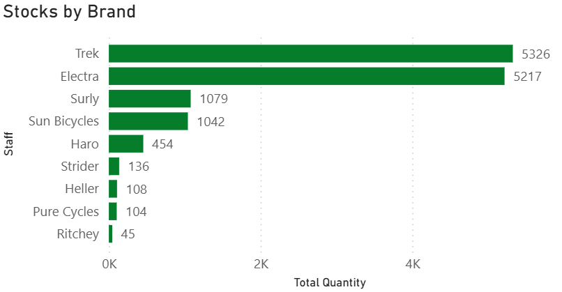
BRAND ANALYSIS
Electra holds the largest customer share at 34.19%, followed by Trek (29.34%) and Surly (13.63%). Other brands like Sun Bicycles (9.13%) and Pure Cycles (4.78%) have smaller but notable portions.
In stock levels, Trek (5326 units) and Electra (5217 units) dominate inventory, while Surly (1079 units) and Sun Bicycles (1042 units) maintain moderate levels.
Smaller brands such as Ritchey (45 units) and Pure Cycles (104 units) have limited stock availability.

Slide 18
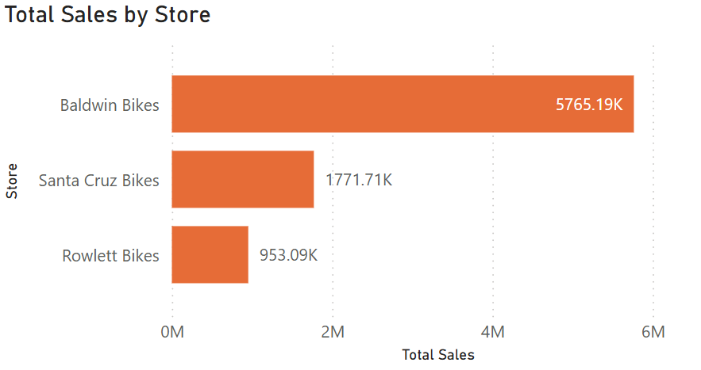
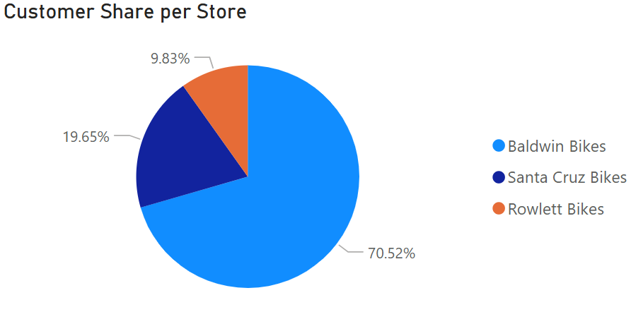
STORE & STAFF ANALYSIS
Baldwin Bikes dominates store sales with 5765.19K, contributing to 70.52% of the total customer share.
Santa Cruz Bikes follows with 1771.71K in sales and 19.65% of customers, while Rowlett Bikes records 953.09K in sales and 9.83% share.
This indicates that Baldwin Bikes is the primary revenue driver, while the other two stores hold much smaller portions of both sales and customer base.

Slide 19
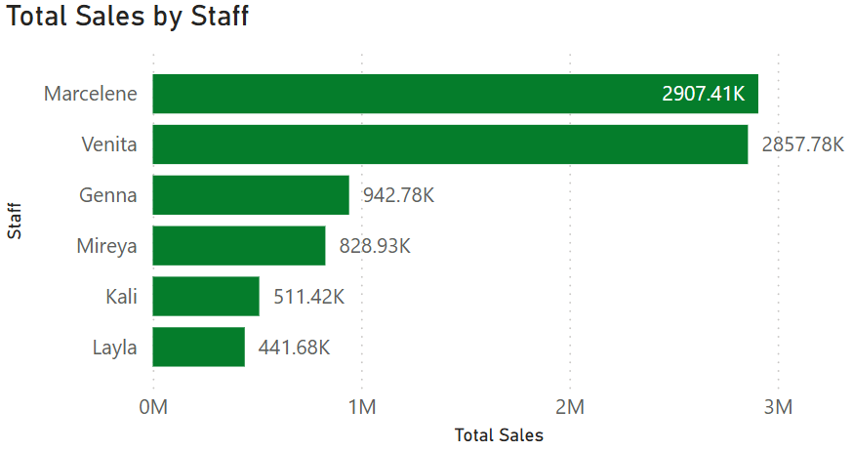

STORE & STAFF ANALYSIS
Marcelene leads staff sales with 2907.41K, closely followed by Venita at 2857.78K, while Genna (942.78K) and Mireya (828.93K) contribute moderately.
Kali (511.42K) and Layla (441.68K) have the lowest sales among the team.
In total orders, Baldwin Bikes dominates with 3195 orders, far ahead of Santa Cruz Bikes (1006 orders) and Rowlett Bikes (521 orders), reinforcing Baldwin’s position as the top-performing store.

Slide 20
BUSINESS SUGGESSTIONS
Low Customer Retention & Incomplete Contact Data
Observation
Out of 1,445 customers, only 131 are repeat buyers (less than 10%). The vast majority are one-time purchasers. Additionally, only 12.32% of customers have mobile numbers available for marketing—the rest have missing contact info.
Impact
Limit's ability to build long-term customer loyalty and reduces the effectiveness of personalized outreach. Marketing campaigns cannot be directly targeted, leading to low repeat sales and missed upsell/cross-sell opportunities.
Solution
Launch loyalty and referral programs, incentivizing repeat purchases.
Enhance data collection at every touchpoint (POS, website, support) to capture customer contact details.
Regularly update and validate customer database; employ email/phone collection campaigns.

Slide 21
BUSINESS SUGGESSTIONS
Volatile Sales Trends & One Time Event Spikes
Observation
Sales peaked dramatically to nearly $900K in early 2018, but collapsed soon after, with minimal recovery. A single month accounted for 63.45% of sales, indicating revenue reliance on isolated events or campaigns.
Impact
Unstable revenue stream makes forecasting and resource planning challenging. High risk during off-peak months, threatening cash flow and business sustainability.
Solution
Develop a balanced annual marketing calendar with regular promotional events.
Diversify product offerings and customer segments to distribute sales more evenly.
Analyze historical data to identify causes behind spikes and replicate best practices across periods.

Slide 22
BUSINESS SUGGESSTIONS
Inventory Imbalances & Low Stock Risks
Observation
About 32% of products (298 items) have fewer than 10 units in stock, and 25 items are out of stock. Meanwhile, over half of inventory (65.6%) remains healthy, often for premium brands.
Impact
Risks of stockouts for popular items, resulting in lost sales, disappointed customers, and lower brand loyalty. Overstock ties up capital and space with slow-moving products.
Solution
Implement automated stock alerts and demand-based replenishment.
Apply ABC analysis for inventory prioritization, focusing on high-impact products.
Coordinate regular inventory audits and optimize purchasing cycles.

Slide 23
BUSINESS SUGGESSTIONS
Overdependence on Top Store and Brand
Observation
Baldwin Bikes alone contributes 70.5% of sales and customer base. Trek dominates sales value (over $5M) despite Electra selling more units, showing a heavy skew to a few stores/brands.
Impact
High business risk if top-performing store/brand face disruptions. Underperformance by other stores/brands limits overall growth and market reach.
Solution
Develop targeted growth strategies for secondary stores and diversify brand promotions.
Invest in staff training and localized marketing in underperforming locations.
Regularly evaluate store/brand KPIs and adapt resource allocation accordingly.

Slide 24
BUSINESS SUGGESSTIONS
Price Range Misalignment & Missed Market Segments
Observation
Majority of products are priced between $500 - $2,000. Only 27% are premium (> $2,000), while 33% are under $500. However, highest sales value comes from premium models; quantity sold is much higher for mid/low-priced items.
Impact
Might miss opportunities in value or budget segments, particularly if inventory or campaigns focus excessively on premium offerings.
Solution
Tailor marketing efforts to highlight value for money and affordable lines to broaden market reach.
Use product segmentation analytics to guide future procurement and pricing strategies.
Bundle promotions or targeted discounts to move inventory across different price categories.

Slide 25
BUSINESS SUGGESSTIONS
Staff Performance Inequalities
Observation
Two staff members (Marcelene & Venita) contribute disproportionately to total sales (combined over $5.7M). Others account for significantly less.
Impact
Indicates uneven training, motivation, or customer assignment strategies. Limits overall sales potential and risks burnout for high performers.
Solution
Establish periodic staff training and mentorship programs, sharing top performer techniques.
Implement fair distribution of leads and customer interactions.
Utilize dashboard KPIs to monitor individual performance and incentivize improvement.
You can use each point as a slide or combine related points for a crisp, actionable presentation.

Slide 26
BUSINESS SUGGESSTIONS
After mid 2018
Observation
After mid-2018, there is a sharp and dramatic drop in sales, falling from a peak of $900K to almost zero, with minimal recovery seen in the subsequent months.
The sales trend chart indicates this collapse was sudden and was preceded by a unique spike, suggesting the peak was driven by a one-time event or campaign rather than sustained organic growth.
No explicit reason for the drop is stated in your slide deck, and there are no references to operational disruptions, product delisting, store closure, or external market impacts within the provided content.
Possible Reasons (Based on Analysis & Context)
Overdependence on singular campaigns/events: Previous sales spikes were concentrated within one particular month (which contributed 63.45% of annual sales), indicating reliance on seasonality or unique promotions. Once the event ended, regular sales activities were insufficient to maintain momentum.
Lack of repeat business: With only 9% repeat customers, returning buyer rates are very low, so there was little customer loyalty to sustain sales after promotional spikes.
Customer data limitations: With only 12% customer mobile numbers recorded, follow-up marketing and re-engagement for post-event retention would have been severely restricted.

Slide 27
BUSINESS SUGGESSTIONS
Inventory and stock issues: While not explicitly linked, it’s possible that popular products went out of stock after the rush, leaving little to sell in subsequent months (see low stock alerts).
Geographic concentration: With most customers in a single state (New York, 70%), local market saturation or changes could have outsized effects on performance.
Impact
Revenue declined sharply, disrupting cash flow and operational planning.
Greater business risk if future campaigns do not repeat past success or if market conditions change.
Impaired long-term growth and competitive positioning due to reliance on isolated peaks.
Solutions
Diversify Marketing Activities
Create a year-round promotional calendar with regular campaigns (holiday, themed, loyalty rewards) to smooth revenue cycles and avoid dependency on single events.
Strengthen Customer Retention Efforts
Invest in loyalty and referral programs to encourage repeat purchases, nurturing a base of customers who provide steady revenue between major campaigns.

Slide 28
BUSINESS SUGGESSTIONS
Solutions
Improve Customer Data Collection
Enhance efforts to record customer contact details during every interaction; use incentives to encourage customers to share information for future communication.
Expand Geographic Focus
Target underrepresented regions (e.g., California, Texas) with marketing and promotions to reduce concentration risk and engage new customer segments.
Inventory Planning
Use sales trend data to forecast demand post-event and align stock replenishment accordingly, ensuring popular products are always available.
Post Event Follow Up
Implement automated re-engagement workflows (email, SMS, targeted ads) immediately after large events or campaigns to convert first-time buyers into repeat customers.
By applying these solutions, you can reduce sales volatility, improve customer lifetime value, and protect overall business health against sudden downturns.

